Slide 1
Notes of Deep Learning
[1]
Part I (chapter 2-5)
[1] Goodfellow, I., Bengio, Y., & Courville, A. (2016). Deep Learning. The MIT Press.

Slide 2
Part I: Applied Math and Machine Learning Basics
Chapter 2. Linear algebra
Chapter 3. Probability and information theory
Chapter 4. Numerical computation
Chapter 5. Machine learning basics

Slide 3
Part I: Applied Math and Machine Learning Basics
Chapter 2. Linear algebra

Slide 4

Linear Algebra
Scalars, Vectors, Matrices and Tensors
Notations:
$s$
$x=\left[\begin{aligned}x_{1} \\ x_{2} \\ x_{3}\end{aligned}\right]$ $S=\left\{1,3\right\}, x_{s} , x_{−S}$
$A A_{:, j} A_{i,:} A_{i,j} {f\left(A\right)}_{i,j}$
$A A_{i,j,k}$

Slide 5
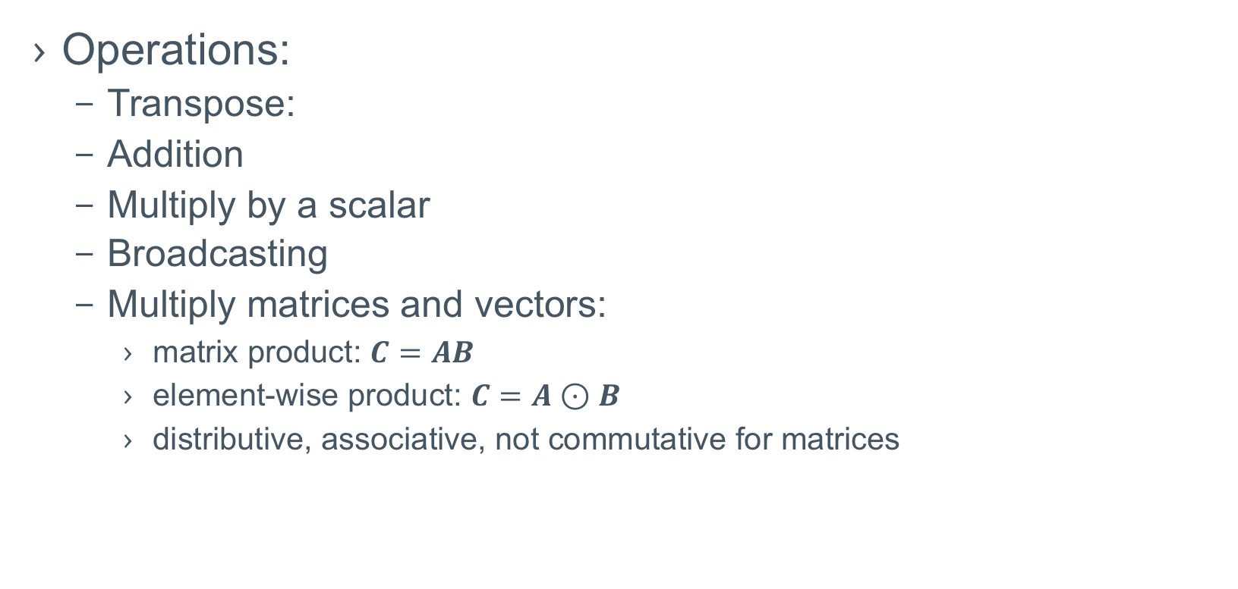
Linear Algebra
Operations:
Transpose:
Addition
Multiply by a scalar
Broadcasting
Multiply matrices and vectors:
matrix product: $C=AB$
element-wise product: $C=A⊙B$
distributive, associative, not commutative for matrices

Slide 6
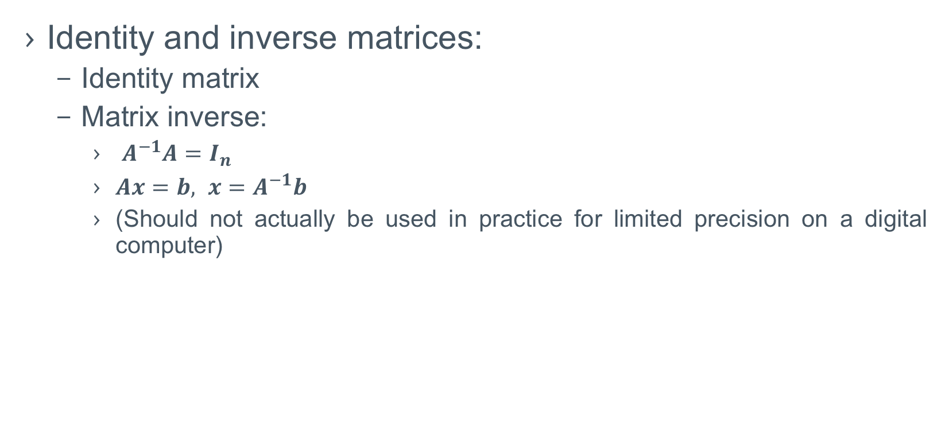
Linear Algebra
Identity and inverse matrices:
Identity matrix
Matrix inverse:
$A^{−1}A=I_{n}$
$Ax=b, x=A^{−1}b$
(Should not actually be used in practice for limited precision on a digital computer)

Slide 7
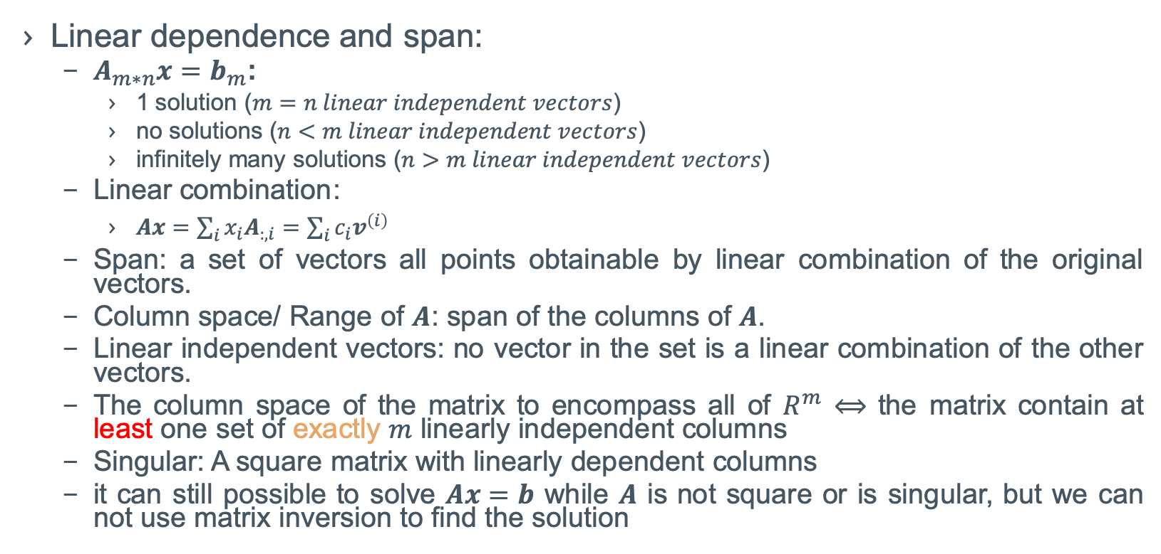
Linear Algebra
Linear dependence and span:
$A_{m∗n}x=b_{m}$:
1 solution ($m=n linear independent vectors$)
no solutions ($n<m linear independent vectors$)
infinitely many solutions ($n>m linear independent vectors$)
Linear combination:
$Ax=\sum_{i}{x_{i}A_{:,i}}=\sum_{i}{c_{i}v^{\left(i\right)}}$
Span: a set of vectors all points obtainable by linear combination of the original vectors.
Column space/ Range of $A$: span of the columns of $A$.
Linear independent vectors: no vector in the set is a linear combination of the other vectors.
The column space of the matrix to encompass all of $R^{m}$ $⟺$ the matrix contain at least one set of exactly $m$ linearly independent columns
Singular: A square matrix with linearly dependent columns
it can still possible to solve $Ax=b$ while $A$ is not square or is singular, but we can not use matrix inversion to find the solution

Slide 8
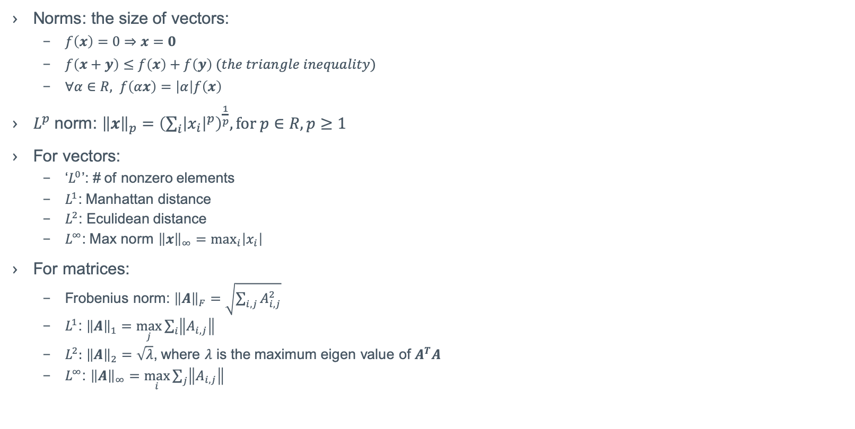
Linear Algebra
Norms: the size of vectors:
$f\left(x\right)=0⇒x=0$
$f\left(x+y\right)≤f\left(x\right)+f\left(y\right) (the triangle inequality)$
$∀α∈R, f\left(αx\right)=\left|α\right|f\left(x\right)$
$L^{p}$ norm: ${\left\|x\right\|}_{p}={\left(\sum_{i}{{\left|x_{i}\right|}^{p}}\right)}^{\frac{1}{p}}, for p∈R, p≥1$
For vectors:
‘$L^{0}$’: # of nonzero elements
$L^{1}$: Manhattan distance
$L^{2}$: Eculidean distance
$L^{∞}$: Max norm ${\left\|x\right\|}_{∞}=\max_{i}\left|x_{i}\right|$
For matrices:
Frobenius norm: ${\left\|A\right\|}_{F}=\sqrt{\sum_{i,j}{A_{i,j}^{2}}}$
$L^{1}$: ${\left\|A\right\|}_{1}=\max_{j}{\sum_{i}{\left\|A_{i,j}\right\|}}$
$L^{2}:$ ${\left\|A\right\|}_{2}=\sqrt{λ}$, where $λ$ is the maximum eigen value of $A^{T}A$
$L^{∞}$: ${\left\|A\right\|}_{∞}=\max_{i}{\sum_{j}{\left\|A_{i,j}\right\|}}$

Slide 9
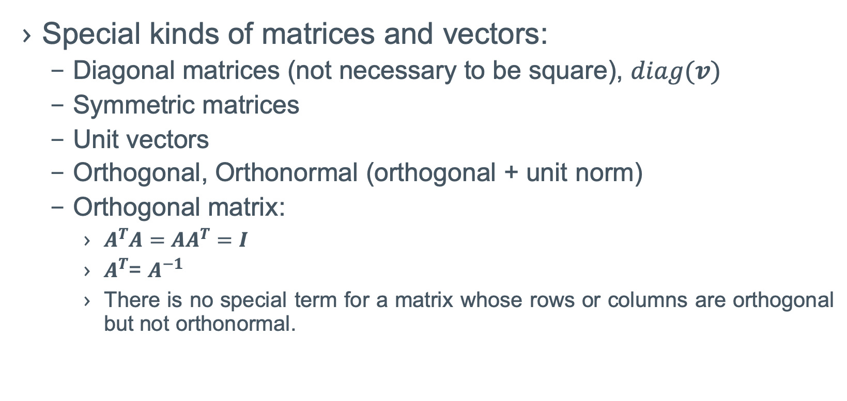
Linear Algebra
Special kinds of matrices and vectors:
Diagonal matrices (not necessary to be square), $diag(v)$
Symmetric matrices
Unit vectors
Orthogonal, Orthonormal (orthogonal + unit norm)
Orthogonal matrix:
$A^{T}A=AA^{T}=I$
$A^{T}$= $A^{−1}$
There is no special term for a matrix whose rows or columns are orthogonal but not orthonormal.

Slide 10
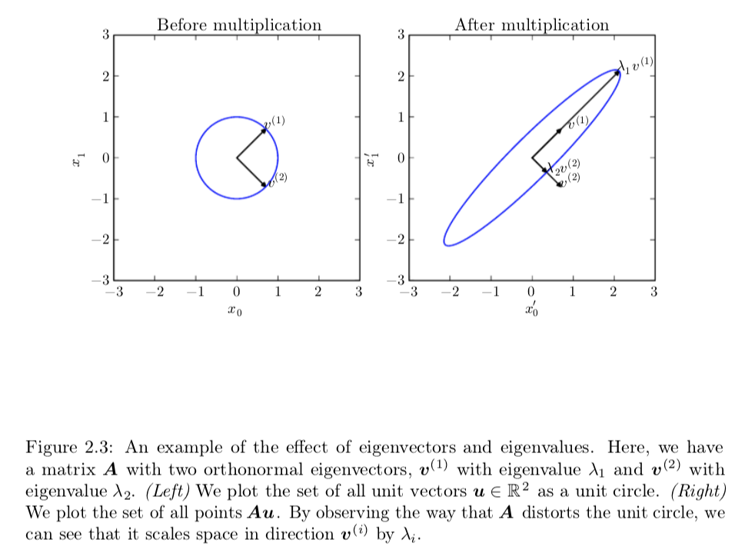
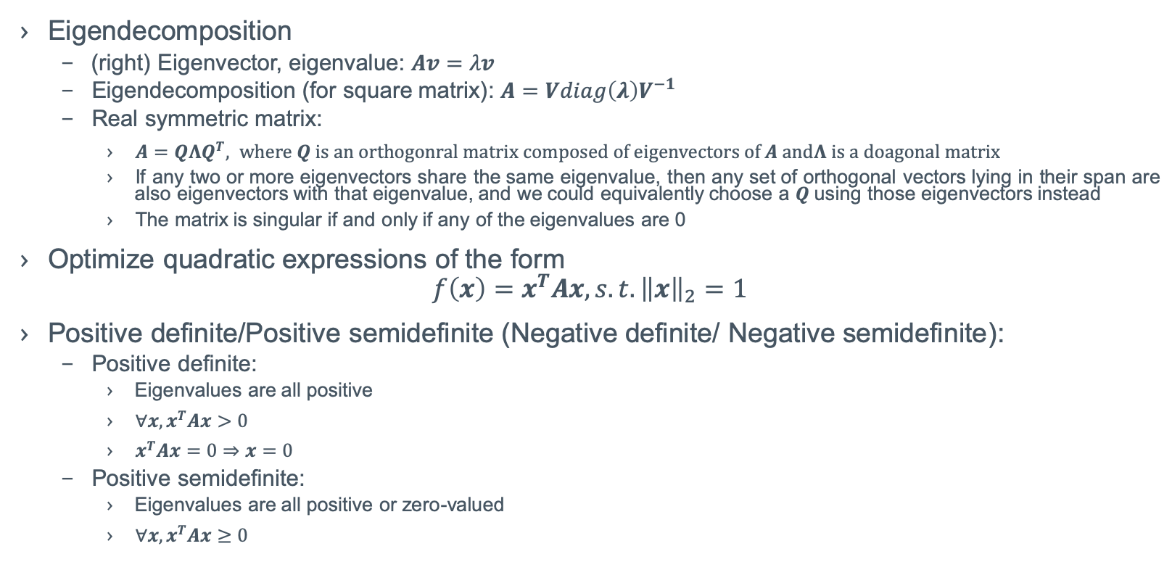
Linear Algebra
Eigendecomposition
(right) Eigenvector, eigenvalue: $Av=λv$
Eigendecomposition (for square matrix): $A=Vdiag\left(λ\right)V^{−1}$
Real symmetric matrix:
$A=QΛQ^{T}, where Q is an orthogonral matrix composed of eigenvectors of A andΛ is a doagonal matrix$
If any two or more eigenvectors share the same eigenvalue, then any set of orthogonal vectors lying in their span are also eigenvectors with that eigenvalue, and we could equivalently choose a $Q$ using those eigenvectors instead
The matrix is singular if and only if any of the eigenvalues are 0
Optimize quadratic expressions of the form
$$f\left(x\right)=x^{T}Ax, s.t. {\left\|x\right\|}_{2}=1$$
Positive definite/Positive semidefinite (Negative definite/ Negative semidefinite):
Positive definite:
Eigenvalues are all positive
$∀x, x^{T}Ax>0$
$x^{T}Ax=0⇒x=0$
Positive semidefinite:
Eigenvalues are all positive or zero-valued
$∀x, x^{T}Ax≥0$

Slide 11



Linear Algebra
Singular value decomposition(SVD)
$$A_{m∗n}=U_{m∗m}D_{m∗n}V_{n∗n}^{T}$$
Left-singular vectors:
Eigenvectors of $AA^{T}$
Elements along the diagonal:
Singular Values
Right-singular vectors:
Eigenvectors of $A^{T}A$

Slide 12
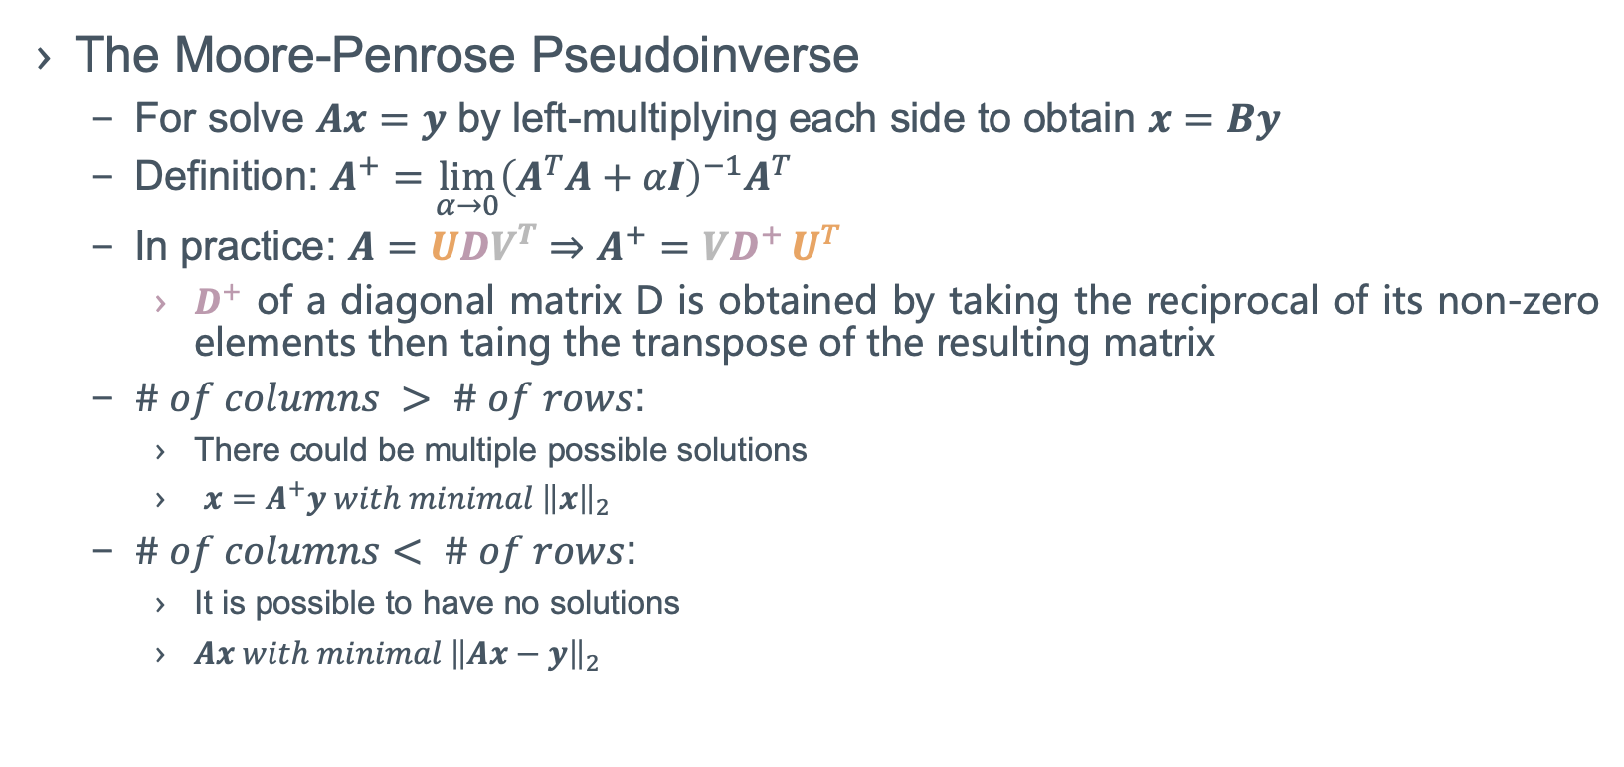
Linear Algebra
The Moore-Penrose Pseudoinverse
For solve $Ax=y$ by left-multiplying each side to obtain $x=By$
Definition: $A^{+}=\lim_{α→0}{{\left(A^{T}A+αI\right)}^{−1}A^{T}}$
In practice: $A=UDV^{T}⇒A^{+}=VD^{+}{U^{T}}$
$D^{+}$ of a diagonal matrix D is obtained by taking the reciprocal of its non-zero elements then taing the transpose of the resulting matrix
$\# of columns > \# of rows$:
There could be multiple possible solutions
$x=A^{+}y with minimal {\left\|x\right\|}_{2}$
$\# of columns< \# of rows$:
It is possible to have no solutions
$Ax with minimal {\left\|Ax−y\right\|}_{2}$

Slide 13
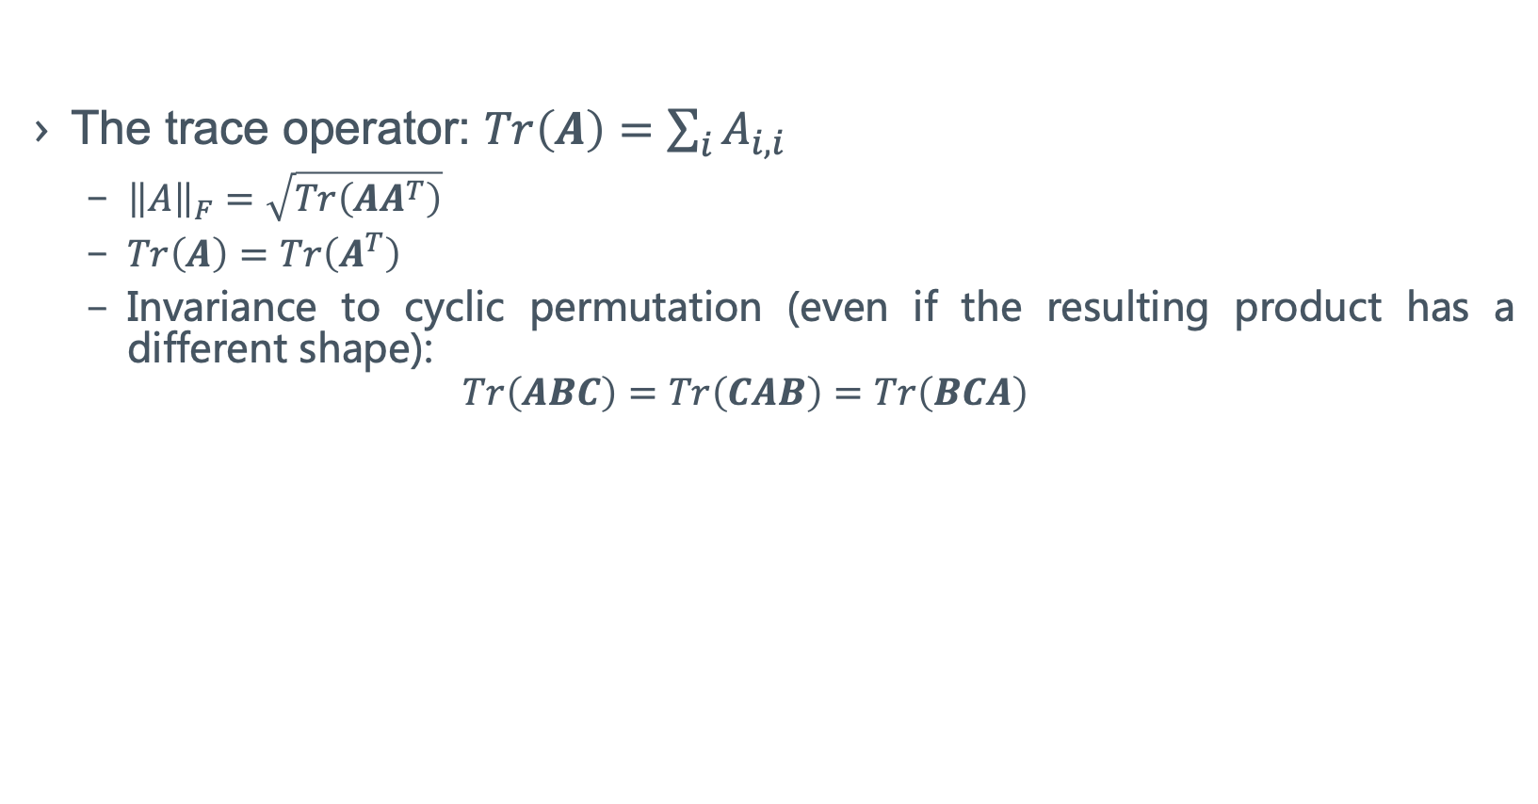
Linear Algebra
The trace operator: $Tr\left(A\right)=\sum_{i}{A_{i,i}}$
${\left\|A\right\|}_{F}=\sqrt{Tr\left(AA^{T}\right)}$
$Tr\left(A\right)=Tr\left(A^{T}\right)$
Invariance to cyclic permutation (even if the resulting product has a different shape):
$$Tr\left(ABC\right)=Tr\left(CAB\right)=Tr\left(BCA\right)$$

Slide 14

Linear Algebra
The determinant: $det\left(A\right)$
$det\left(A\right)=product of all the eigenvalues of the matrix$
A measure of how much multiplication by the matrix expands or contracts space:
If it is 0, then space is contracted completely along at least one dimension, causing it to lose all of its volume
If it is 1, then the transformation is volume-preserving

Slide 15

Linear Algebra
An example: Principal Components Analysis (PCA)
Target:
$$c^{∗}=\min_{c}{{\left\|x−g\left(c\right)\right\|}_{2}}$$
Solution:
$$\max_{d}{Tr\left(d^{T}X^{T}Xd\right)}s.t. d^{T}d=1$$

